Slide 1
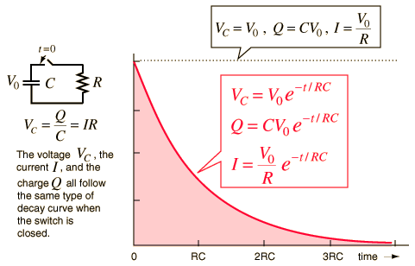
Charging of a Capacitor
RC time constant – time it takes capacitor to charge or discharge by 63% - “electrical response time”
http://hyperphysics.phy-astr.gsu.edu

Slide 2
Memorize it:
At t = τ…

Slide 3
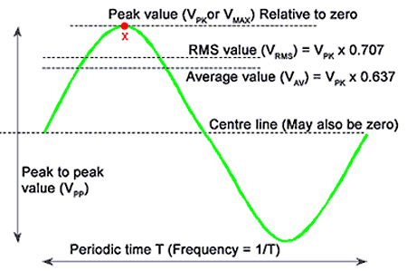
Alternating Current (AC)
www.learnabout-electronics.org
|V| “peak amplitude”
V_{pp} = 2|V| “peak-to-peak”
“root-mean-square”

Slide 4
Memorize it:

Slide 5
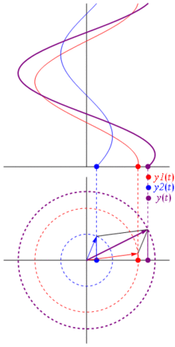
Alternating Current

Slide 6
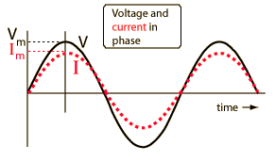
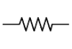
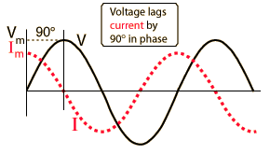
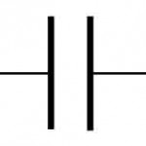
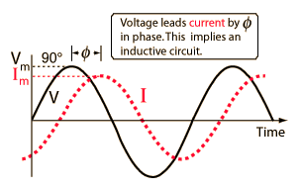
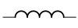
Phase
Resistor
R
Capacitor
C
Inductor
L
http://hyperphysics.phy-astr.gsu.edu

Slide 7
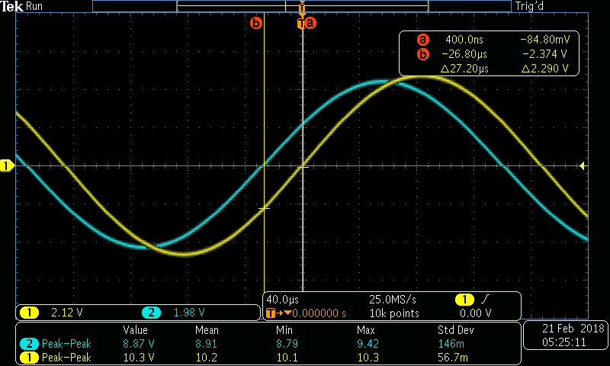
A5 – Electronics II
Amplitude
Phase

Slide 8
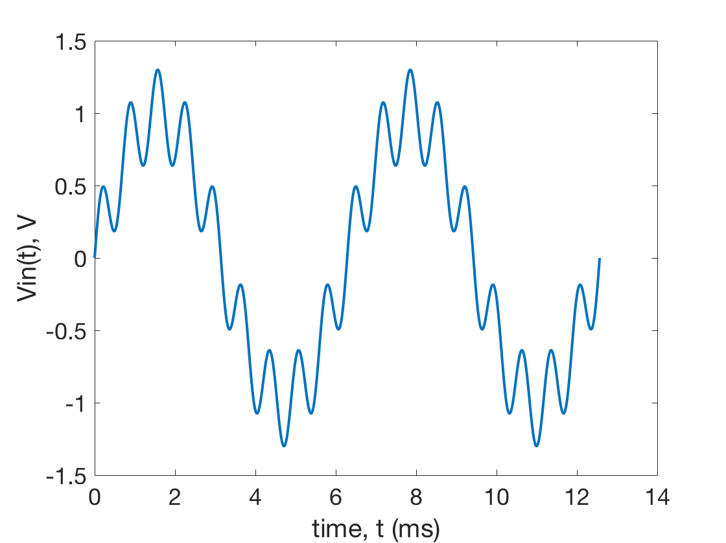
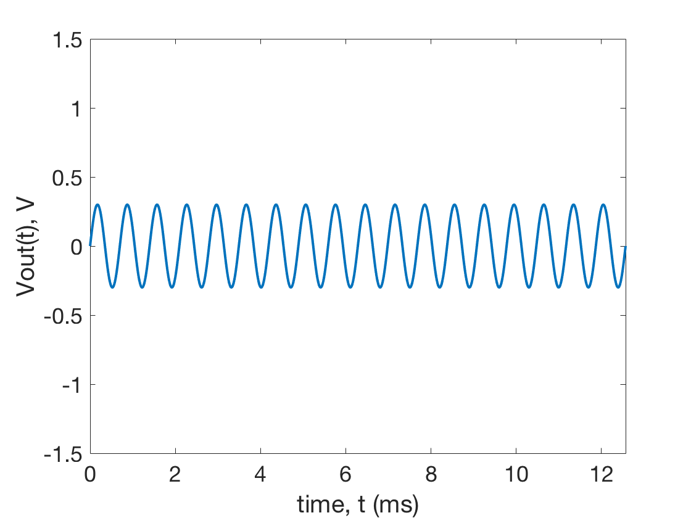
High-Pass Filter

Slide 9
A5 – Electronics II
Amplitude
Phase

Slide 10
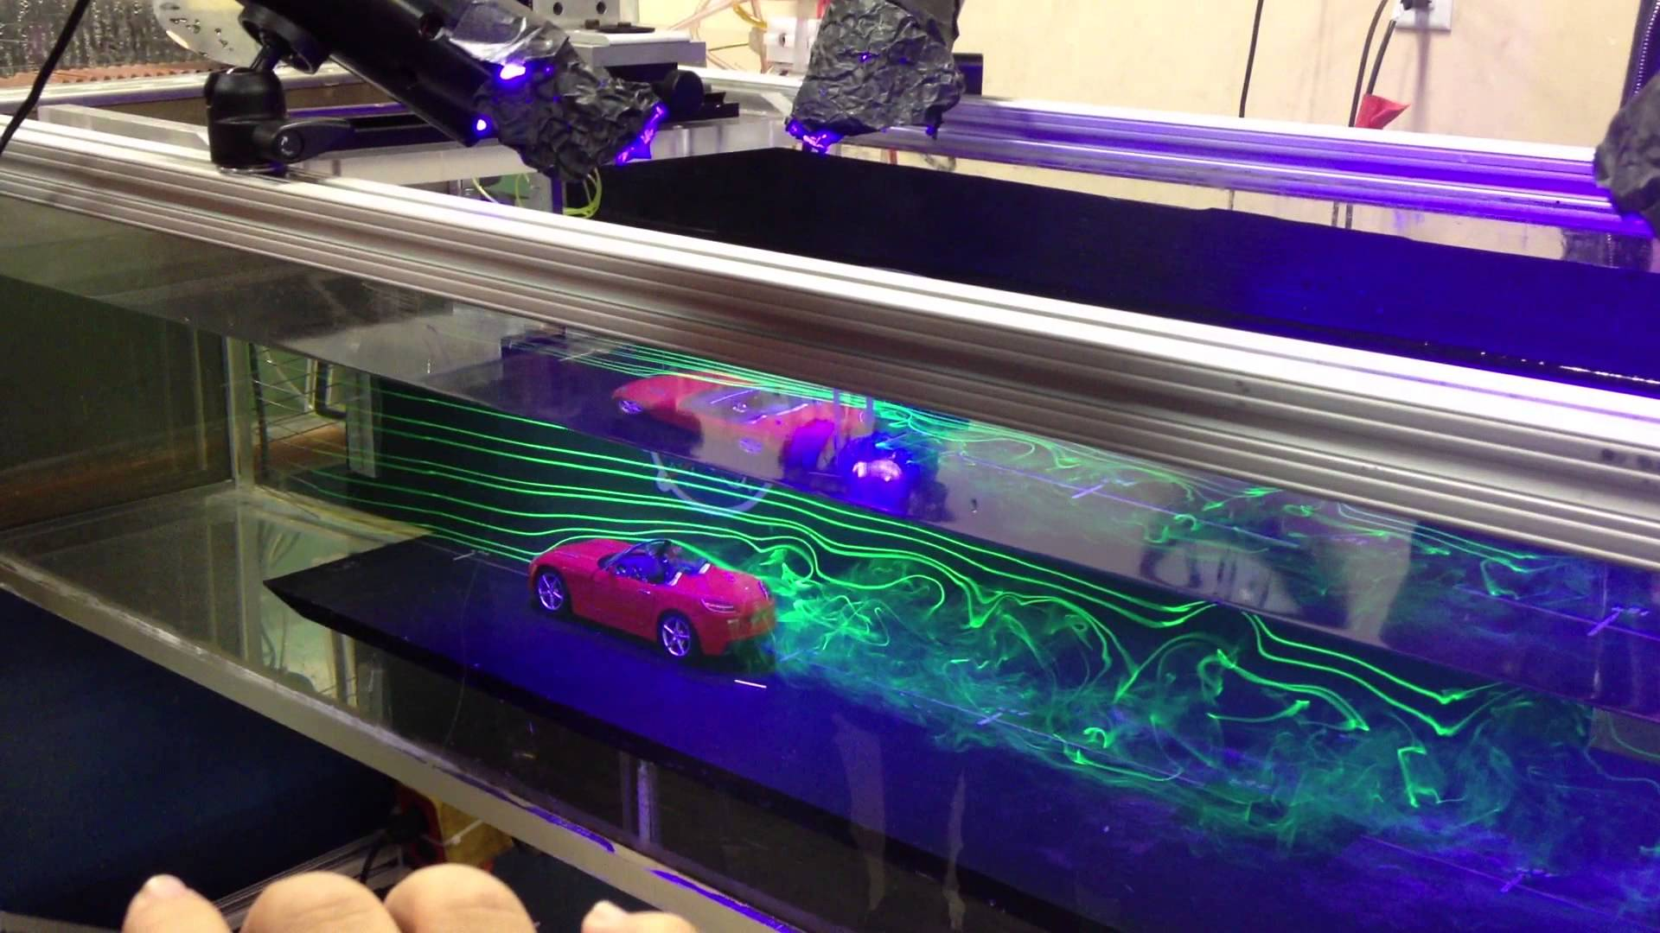
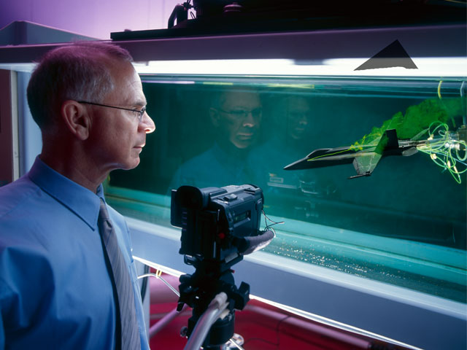
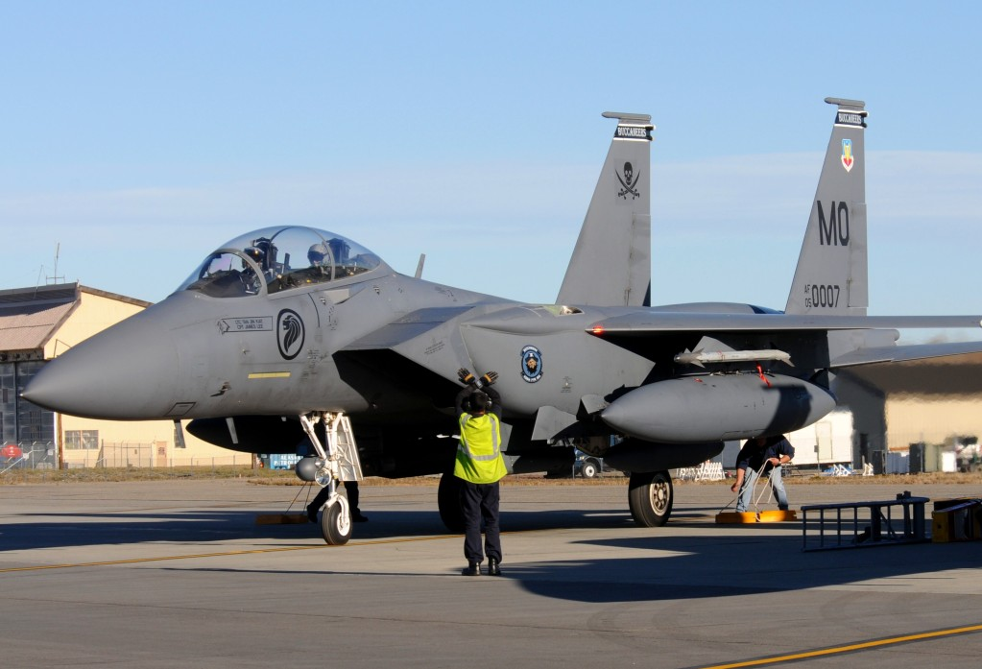
Non-dimensional Parameters
Reynolds Number

Slide 11
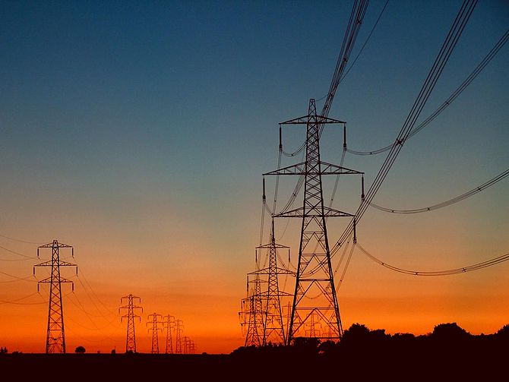
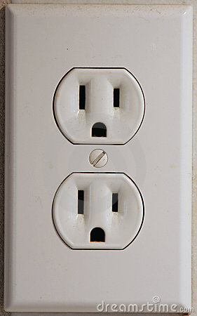
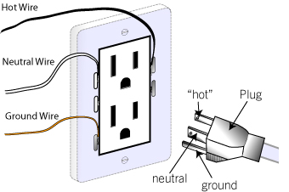
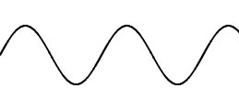
The AC Power Grid
60 Hz, 120 V_{RMS}

Slide 12
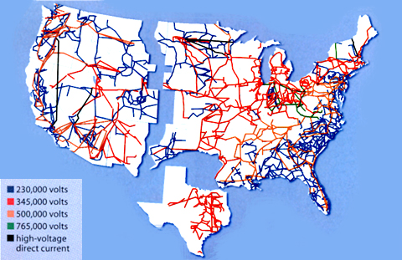
The AC Power Grid
Electrical energy distributed across nation via AC transmission lines.
https://www.technologyreview.com/s/401083/a-smarter-power-grid/

Slide 13
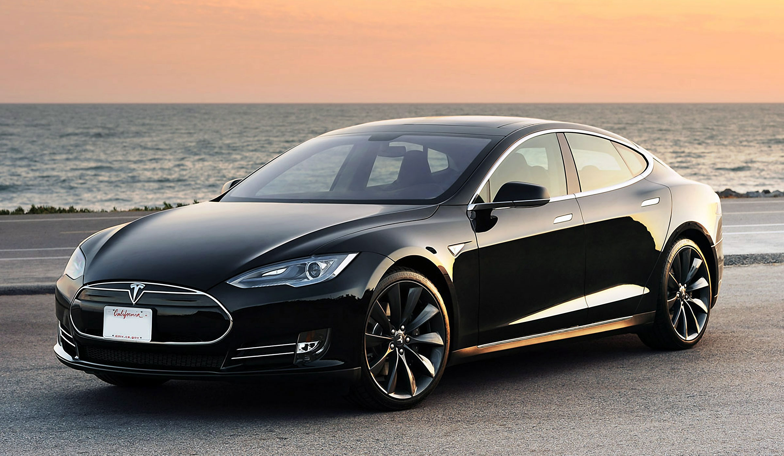
Tesla Models S – 400 HP AC Induction Motor

Slide 14
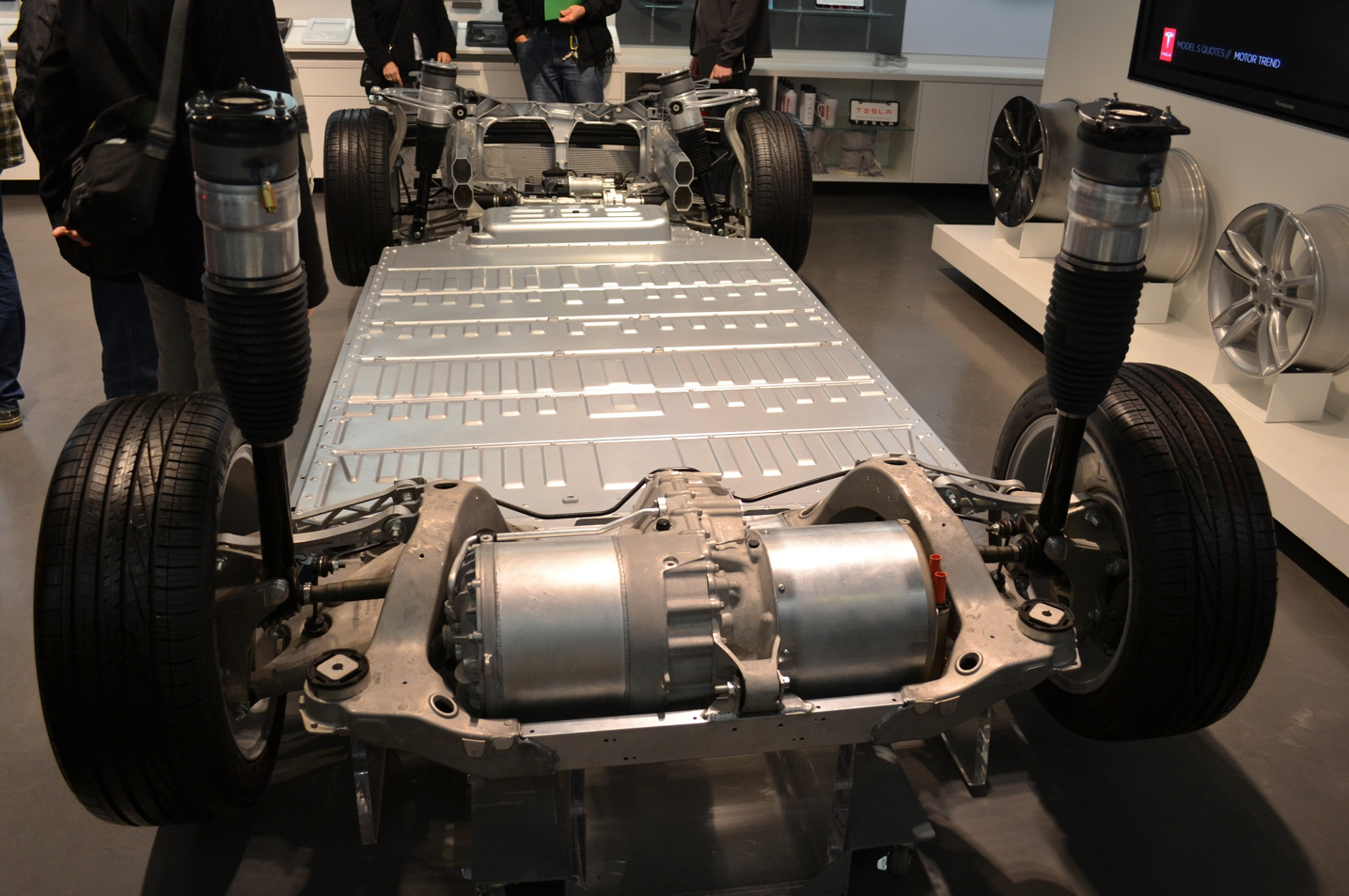
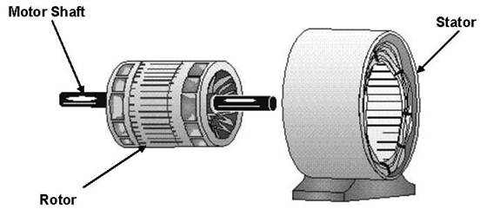
55 Hz AC Induction Motor – 10³ Amps at 300 V
300,000 W = 400 HP
Instantaneous torque!
No transmission, no fuel pump, no water pump, no valves… Very few moving parts!

Slide 15
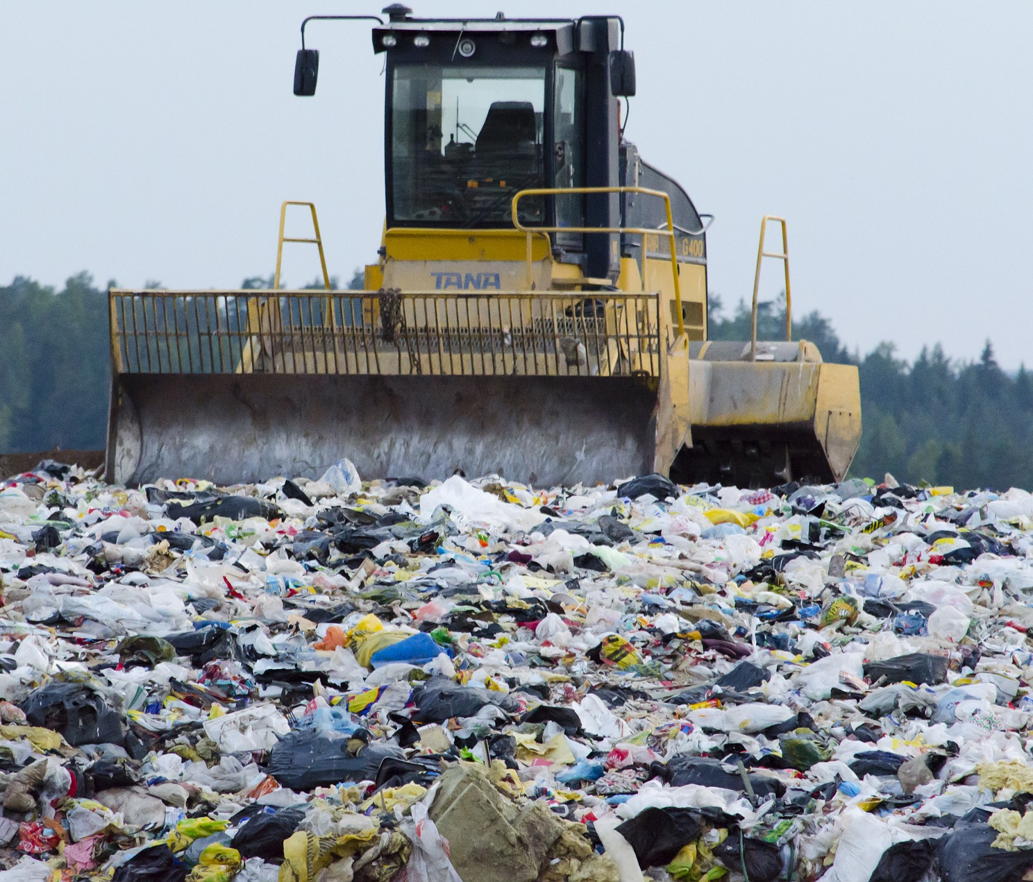
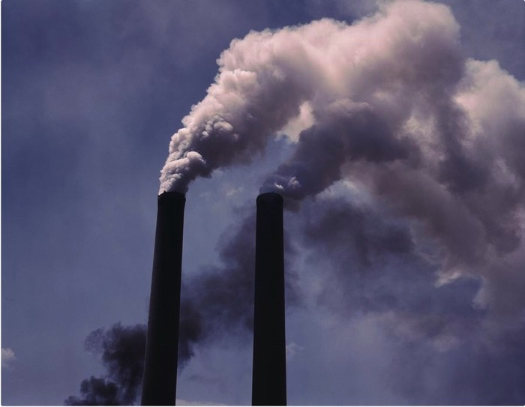
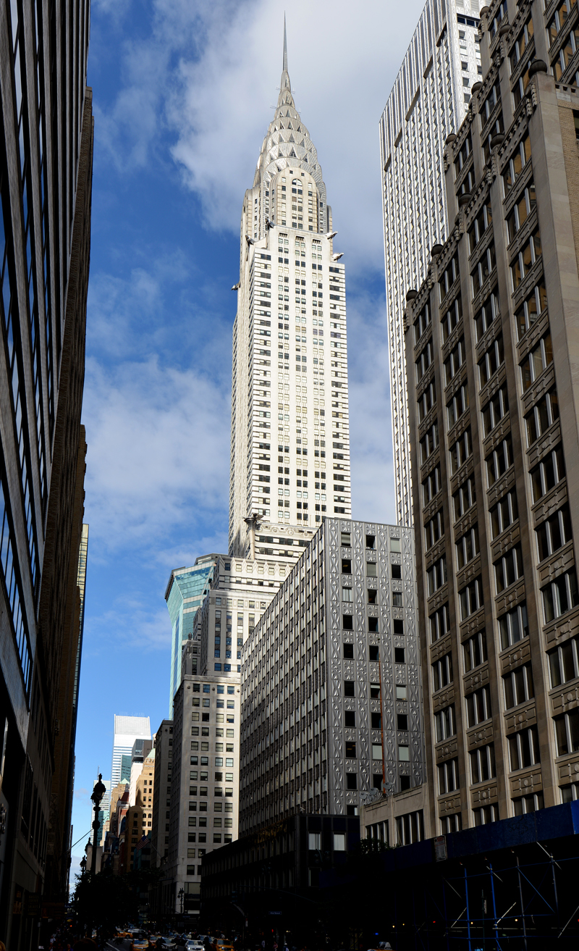

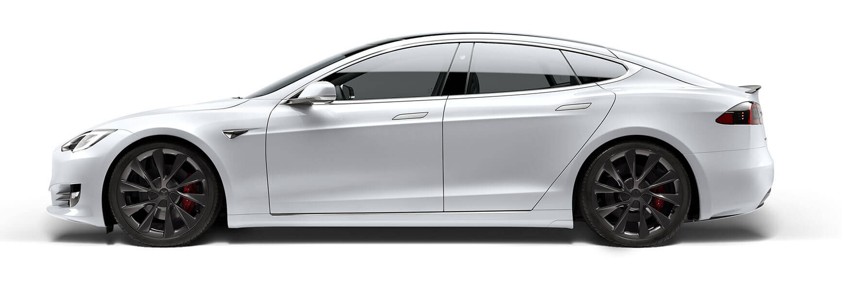

Energy Consumption
Entropy
Output
Waste heat:
2x10¹² W
~66% wasted
Energy Input
Work Output
Economy
GDP and $$$
3x10¹² W (3 TW)
~10,000W per person!
1x10¹² W
~34% used

Slide 16
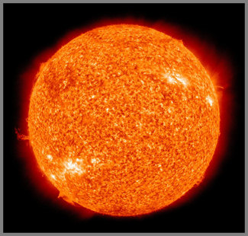
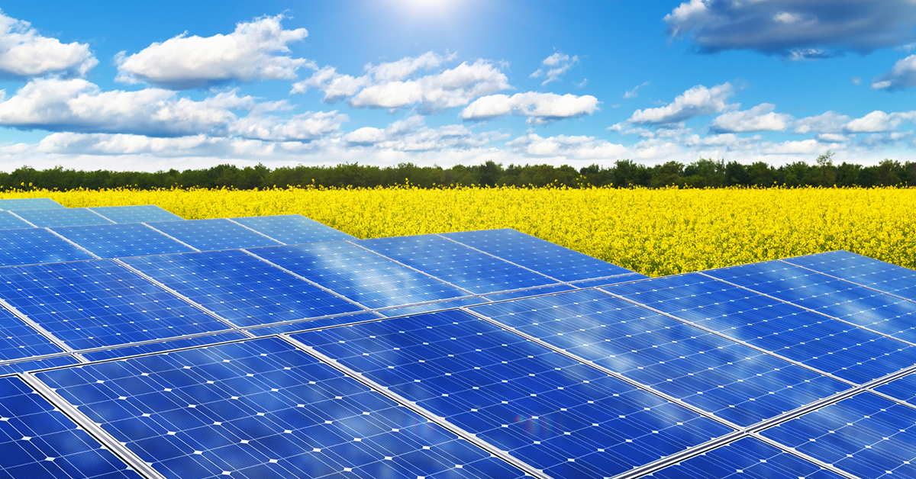

A6 and A7 - Solar Panels
173 Million GigaWatts of power are incident on planet earth!
10,000 times more than total human consumption.

Slide 17
Solar “Microgrid”
Solar energy is often stored in batteries for use at night.

